Slide 1
Welcome to MSDS 6371 Statistical Foundations Live Session 13, February, 2 ,2021
Announcements
Instructor: Dr. Martin Selzer
Office Hours (Schedule Appointment by Email)
Teaching Assistant is Michael Wang
My email martin.selzer@gmail.com and mselzer@mail.smu.edu
Project is available in the files folder. Project is due February 16th.
Final Exam is scheduled for Saturday February 20th 11:00 A.M. CST
Session 14 is a project review, so bring questions or submit to me by email in advance.
Session 15 is a review session before the midterm. Reschedule to Saturday February 13 9:30 AM CST?

Slide 2
Agenda Session 13
Breakout – Live Session Questions 20 Mins 20
Review Live Session Answers 60 Mins 80
Summary, Questions 10 Mins 90

Slide 3
Session 13 Regression Modeling Techniques
Influential Observations
Quadratic Terms
Multicollinearity
Subset Regression Using F-statistic
Variable Selection Algorithms
Eliminating Variables Logically

Slide 4
Purposes of Modeling Techniques
Modify data to meet assumptions
Normality
Constant Variance
Better Model Fit in terms of R² and residuals
Interpretability of effects explaining variability in a dependent variable
Parsimony – Fewer variables the better

Slide 5
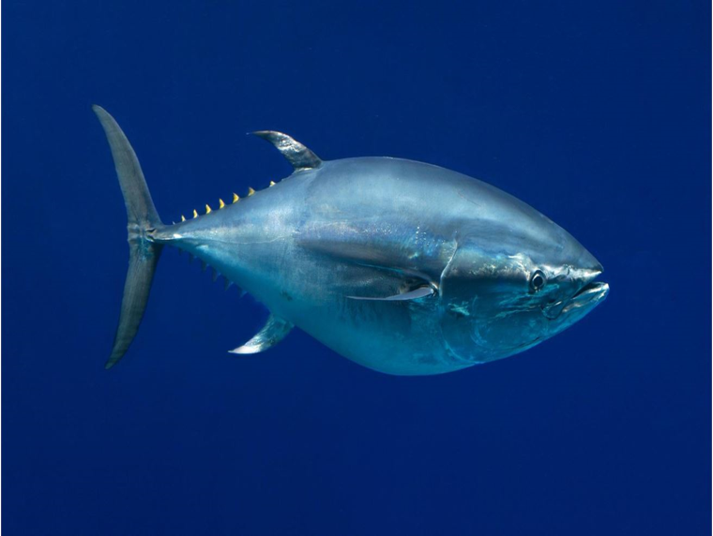
Quadratic Variables in Model
Researchers are interested in understanding the relationship of body length and age for Blue Fin Tuna. They think that body length levels off at some age. They collect data on 78 fish to investigate this relationship.

Slide 6
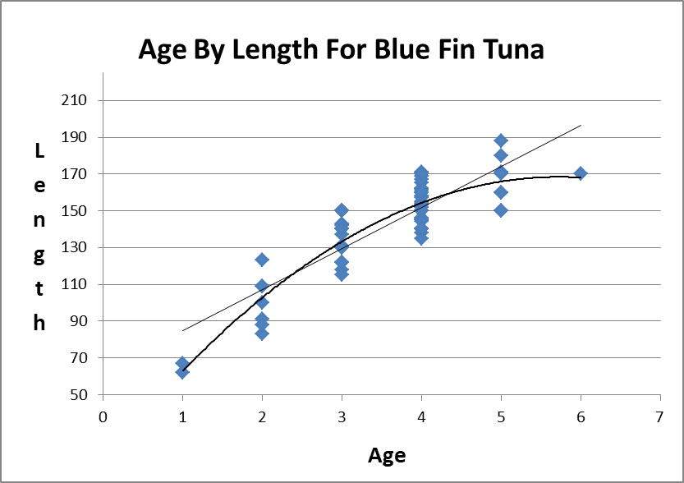
Blue Fin Data Graphic of Linear and Quadratic Relationship

Slide 7

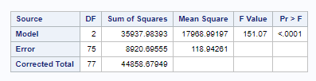

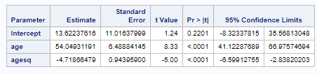
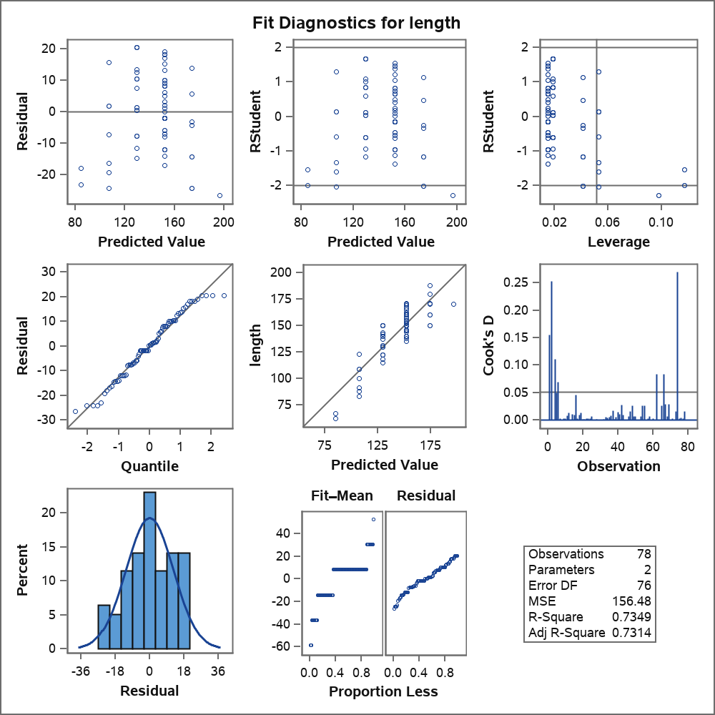



Blue Fin Data Models
Linear
$$length= β_{0}+β_{1}age$$
Quadratic
$$length= β_{0}+β_{1}age{+β}_{2}age2$$

Slide 8
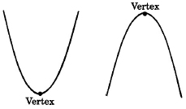
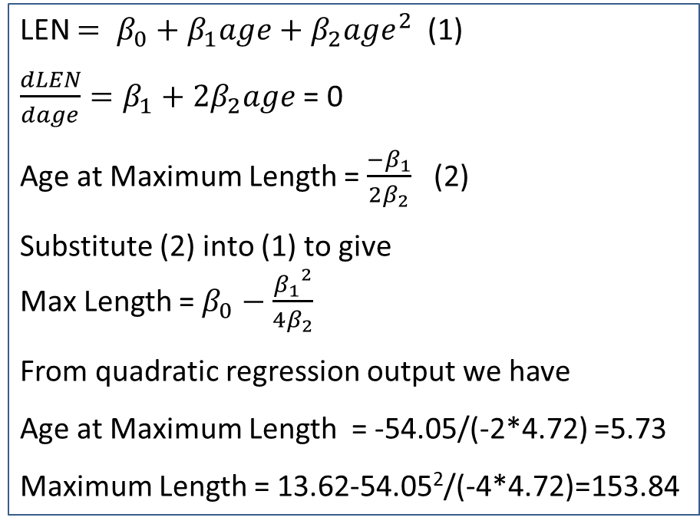

At What Value of Age Does Length Stop Increasing
Calculas
$\left(\frac{−β_{1}}{2β_{2}},{ β}_{0}−\frac{{β_{1}}^{2}}{4β_{2}}\right)$ => Age and maximum length
LEN $= β_{0}+β_{1}age+β_{2}{age}^{2}$ (1)
$\frac{dLEN}{dage}=β_{1}+2β_{2}age$ = 0
Age at Maximum Length = $\frac{−β_{1}}{2β_{2}}$ (2)
Substitute (2) into (1) to give
Max Length = $β_{0}−\frac{{β_{1}}^{2}}{4β_{2}}$
From quadratic regression output we have
Age at Maximum Length = -54.05/(-2*4.72) =5.73
Maximum Length = 13.62-54.05²/(-4*4.72)=153.84

Slide 9
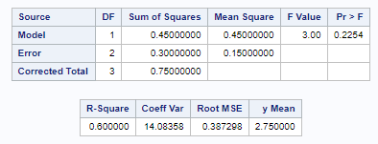
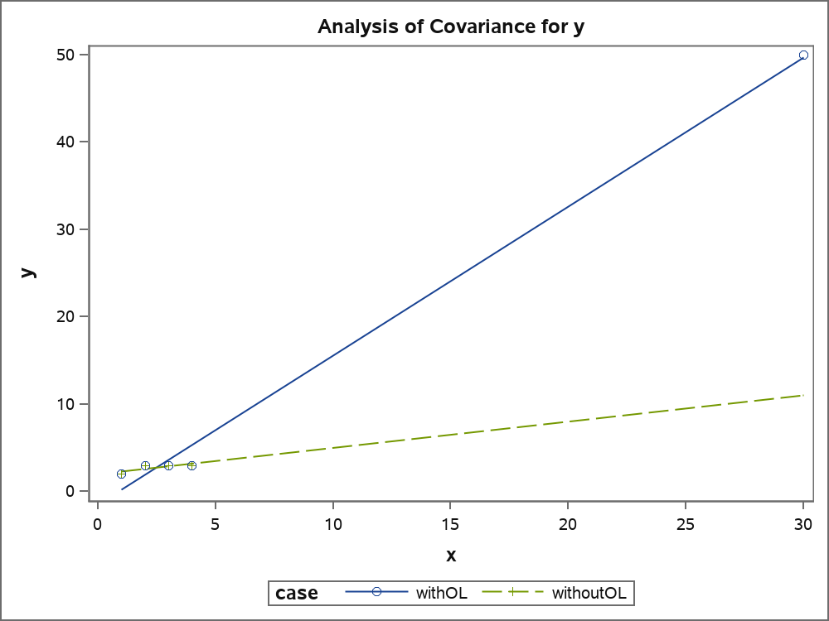

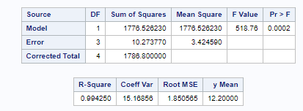

Effects of Outliers on Linear Models
Analysis w/o Outlier
Analysis with Outlier

Slide 10
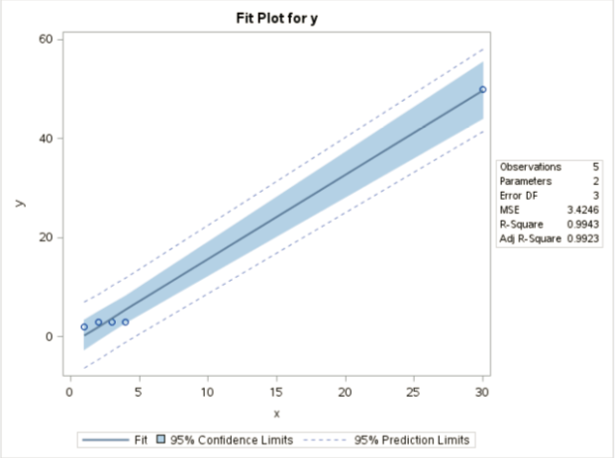





The Idea of Leverage
$$x_{1}$$
$$\overline{x}$$
$$x_{5}$$
$${(x}_{1}−\overline{x})$$
$${(x}_{5}−\overline{x})$$

Slide 11

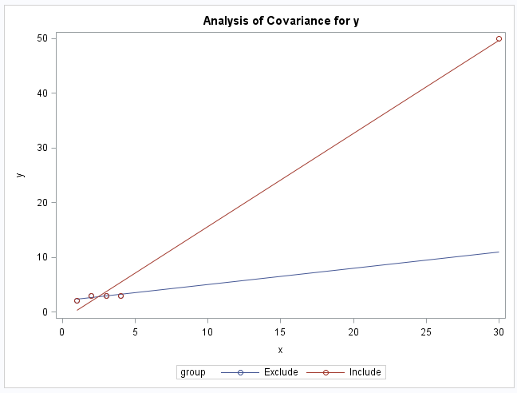
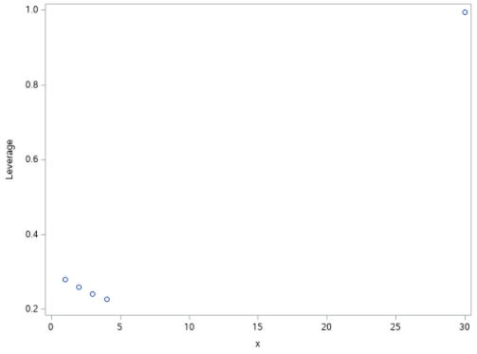
Definition of Leverage With One Explanatory Variable
Leverage is a function of the distance from X_{i} to X̄, in units of standard deviations
Leverage is a function of the proportion of the total sum of squares of the explanatory variable contributed by the i^{th} case
x_{bar}
x_{i}

Slide 12
Studentized Residuals and Cook's D
Leverage

Slide 13
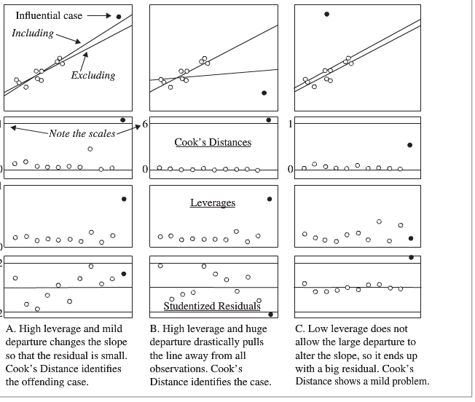
Studentized Residuals, Leverage and Cook’s D!
Example 1
Example 2
Example 3

Slide 14
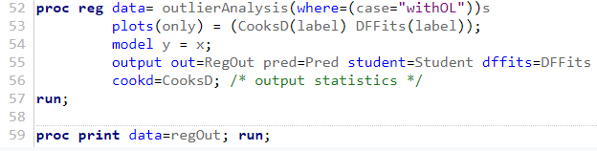
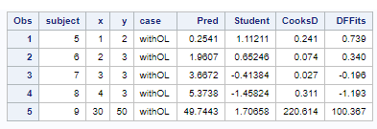

Proc Reg in SAS to Get Values of Cook's D and Studentized Residuals
DFFITS_{i}= ${studres}_{i}\sqrt{\frac{h_{i}}{1−h_{i}}}$

Slide 15
Multicollinearity Issues
One goal in regression modeling is parsimony, i.e., as few independent explanatory variables as possible.
Explanatory variables correlated with each are candidates to be removed from the model.
Use scatter plots to investigate relationships between variables.
Use correlation matrix to investigate correlations between variables.
Good old common sense.

Slide 16
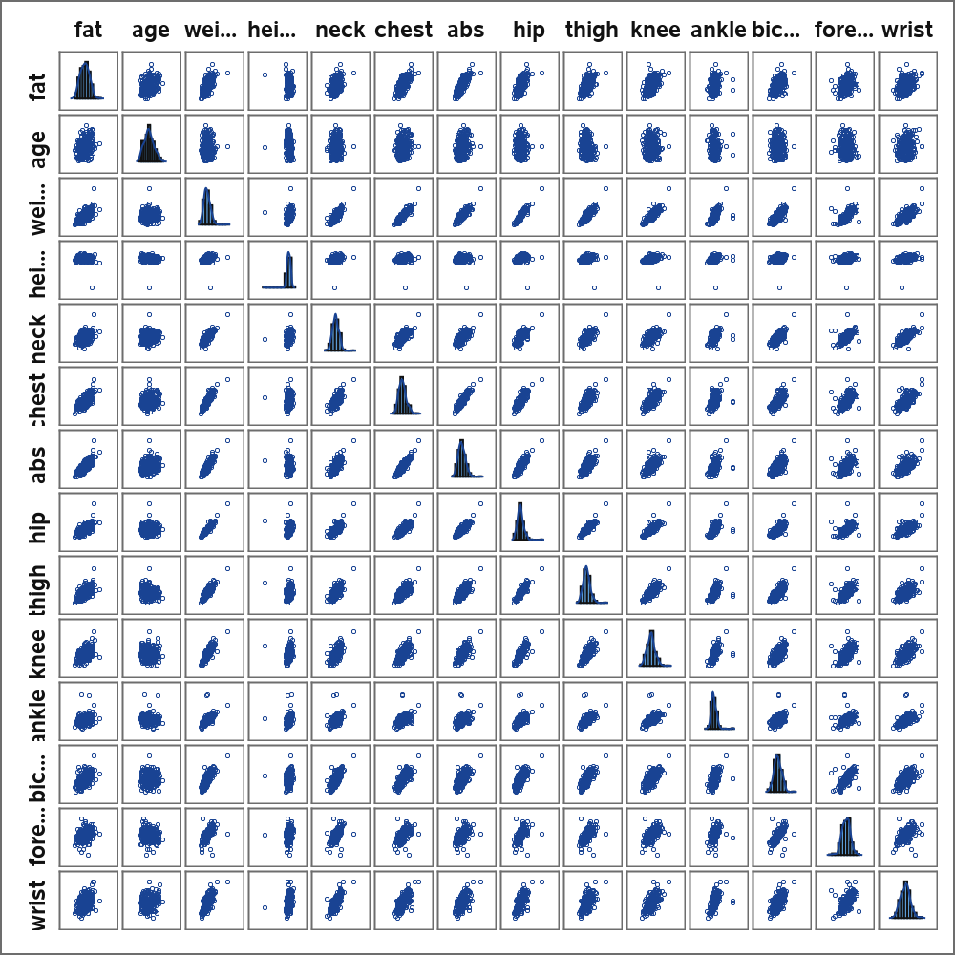
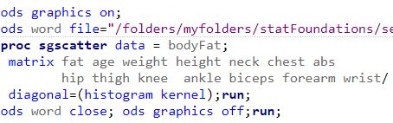
Example: Understanding Body Fat in Relation to Other Anatomical Measurements with Scatterplot (LS 14.9)
See Live Session 14.9

Slide 17
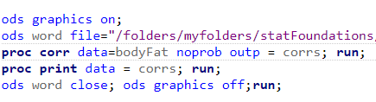
Example: Body Fat with Anatomical Measures Corr Matrix
Do density and fat measure the same thing?

Slide 18
Example: Code Output for Body Fat with Anatomical Measures also gives Corr Matrix List Format

Slide 19
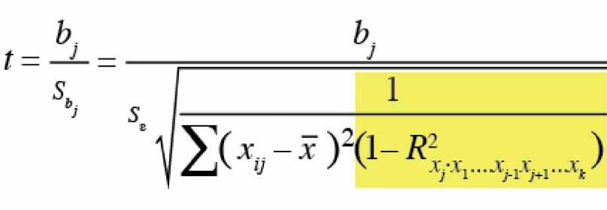

Variance Inflation Factor (VIF) for Given Explanatory Variable
Find R² from regression of particular variable on the other explanatory variables.
VIF is part of the t statistic for the beta coefficient from the full model.
For large VIF consider dropping variable from model.
With multiple variables with large VIF use caution in analysis because the variables in question may be correlated. Drop variable with larger VIF.
VIF

Slide 20
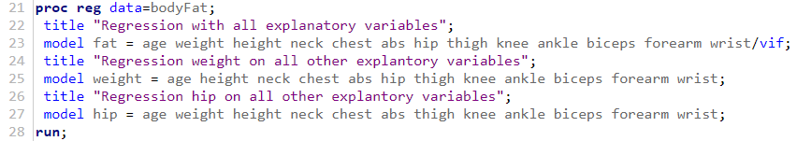
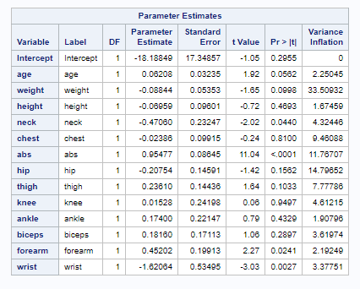
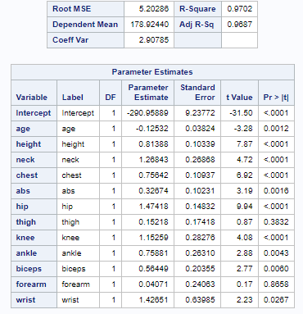
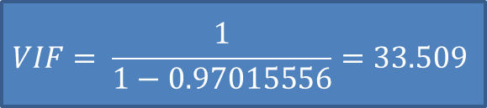
Calculate VIF
Regression of Fat on All Explanatory Variables
Regression of Weight on All Other Explanatory Variables
$$VIF= \frac{1}{1−0.97015556}=33.509$$

Slide 21
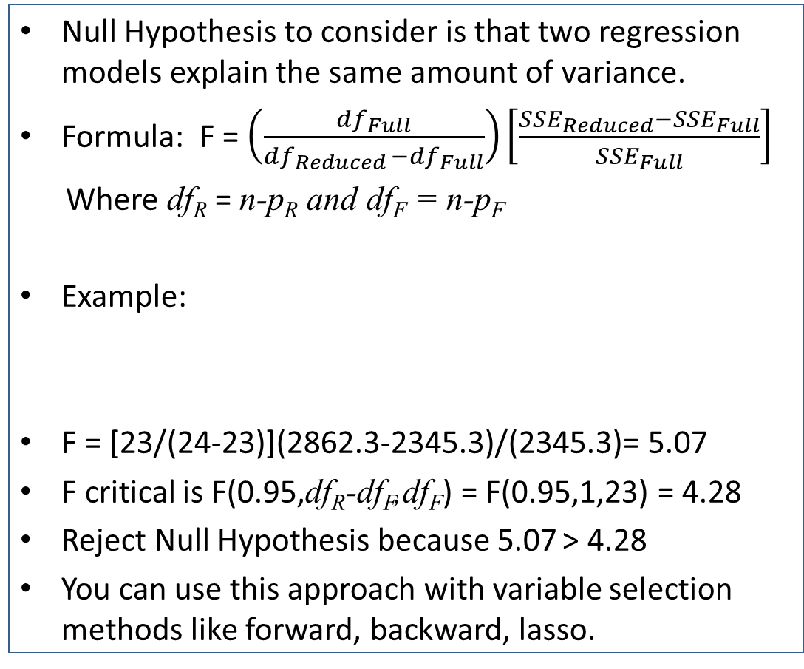
Extra Sums-of-Squares F-tests To Compare Models Can Use the F-Statistic
Null Hypothesis to consider is that two regression models explain the same amount of variance.
Formula: F = $\left(\frac{{df}_{Full}}{{df}_{Reduced }−{df}_{Full}}\right)\left[\frac{{SSE}_{Reduced}−{SSE}_{Full}}{{SSE}_{Full}}\right]$
Where df_{R} = n-p_{R} and df_{F} = n-p_{F}
Example:
F = [23/(24-23)](2862.3-2345.3)/(2345.3)= 5.07
F critical is F(0.95,df_{R}-df_{F},df_{F}) = F(0.95,1,23) = 4.28
Reject Null Hypothesis because 5.07 > 4.28
You can use this approach with variable selection methods like forward, backward, lasso.
Note that for variable selection, the full model is the model being evaluated in comparison to an accepted reduced model.

Slide 22
Traditional Variable Selection Methods
Forward selection, backward elimination, stepwise selection
Backward and forward are computationally cheapest
Stepwise (the default) not much more costly, checks back and forth. Checks model with variable in and then variable in with each other variable out.
Maxr option much more expensive
Considers pairs of variables in ways possibly missed by stepwise
Maxr stop=4 option only considers models with four or fewer variables
Minr, alternative to maxr, even more costly
Force variables into the model using the "include" or "start" statements (Used with stepwise)
Model y = x1 x2 x3 / include=2 /*force in the first 2 variables in data*/
Model y = x1 x2 x3 / start=2 /*2 variables must be in the model before elimination is considered but not necessarily the first 2*/

Slide 23
Newer Model Selection Methods Lasso and Lar
Least absolute shrinkage and selection operator (LASSO)
Adds and deletes parameters based on a version of ordinary least squares where the sum of absolute regression coefficients is constrained
Introduces bias in coefficient estimation with intention to reduce variance. Seeks to reduce MSE = Bias² + Variance.
Least angle regression (LAR)
Starts with no effects in the model and adds effects
Requires centering and scaling of the observations
LAR and forward-stagewise algorithms referred to collectively as LARS
Object of both: Minimize sum of squared residuals according to a constraint
Constraint = sum of absolute values of parameter estimates < given constant
Variables added according to correlation with residuals
Note: Ordinary Least Squares (OLS) gives unbiased estimates.

Slide 24
What is Internal Cross Validation for evaluating models? (Uses CV Press Statistic for Model Fit)
Choose the number of times to estimate the parameters of a model (maximum number of times is n for leave out one observation (This is like using a PRESS statistic). SAS uses a default of 5 if the number of times to test the model is not specified.)
Leave out some number of observations and fit the model in each estimation iteration. In SAS the observations are randomly assigned to each iteration for omission (see SAS documentation proc glmselect, model statement, CVMethod).
With the parameters estimated for each iteration, calculate the sum of the squared estimated errors using the omitted observations.
Get a measure of goodness of fit for the model by summing the squared estimated errors from each iteration. This is the CVPress statistic.
In SAS, the CVPress option does a five fold (iteration) cross validation by default i.e., it derives estimates from leaving out observations and computes the sum of squared errors from those observations and does this five times.
Using the Press (as distinct from CVPress) statistic as a goodness of fit statistic is like doing an n-fold cross validation to compare models i.e, like estimating n models where each model leaves out one observation.

Slide 25
The CVPress Statistic Calculation for Internal Cross Validation to Evaluate Model Fit

Slide 26
Measures Available to Compare Models
F-Statistic
Adjusted R-Square
CV Press
Others

Slide 27
External Cross Validation Train and Test Data Sets
Divide incoming data into Train and Test data sets.
Train data set is used for modeling and variable selection.
Test data set is used with parameter estimates from the Train Data at different steps in the modeling to evaluate if the modeling with the Train data set can be replicated with the Test data.

Slide 28
Consider Data Set Below to Understand the Determinants of SAT Scores
Data From Case Study 1201 in Text
SAT: Test Score
Takers: % taking test
Income: Median income
Years: Years of formal study
Public: % attend public school
Expend: $/student
Rank: Median class rank of takers

Slide 29
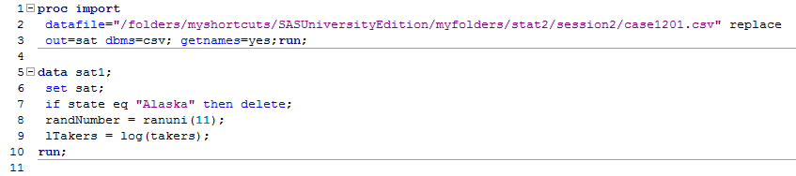
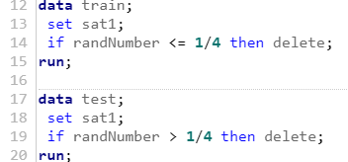
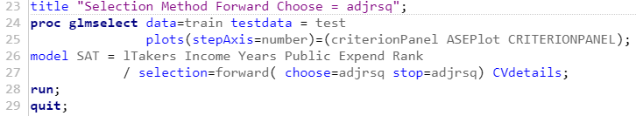
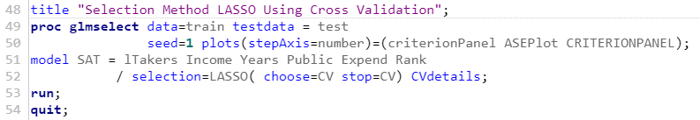
Important Elements for SAS Code Using proc glmselect cand Variable Selection Methods
Create train dataset
Create random variable > 0 and <=1
Exclude Alaska outlier
Create test dataset
Using train and test datasets to evaluate models is referred to as External Cross Validation.
;
Forward variable selection indicated
adjRsq test measure for model
LASSO variable selection indicated
Note: PRESS Acronym is Predicted Residual Error Sum of Squares
Internal Cross Validation with CVPress test statistic as default. CVMethod = random(5) default , others Block, Split

Slide 30
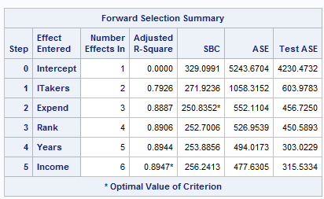
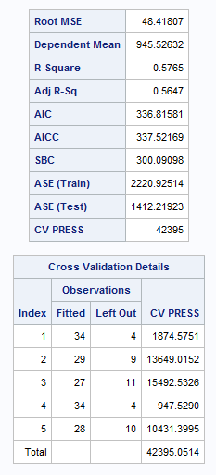
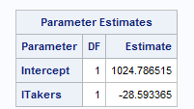
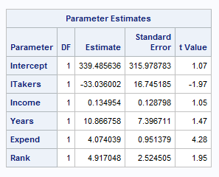
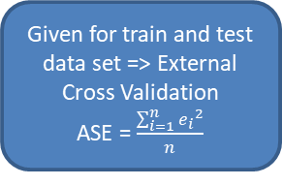
Results SAT Variable Selection Models
Forward Selection
Lasso Selection
Stop Here?
Given for train and test data set => External Cross Validation
ASE = $\frac{\sum_{i=1}^{n}{{e_{i}}^{2}}}{n}$
|t| > 2 => significance
38 observations in train data set which is approximately 0.75*49

Slide 31
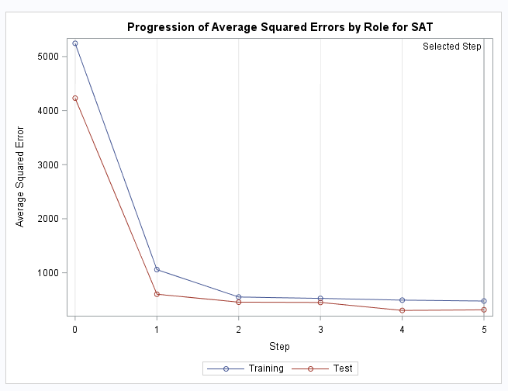
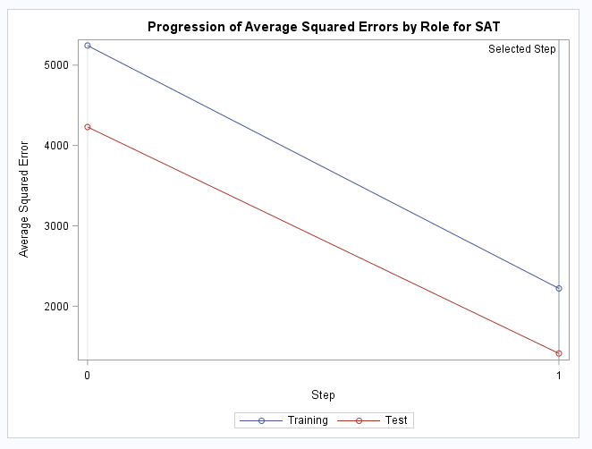
External Cross Validation SAT Variable Selection Models
Forward Selection
Lasso Selection

Slide 32
Live Session Question
A appliance producer creates metal frames for the products it manufactures. It wants to understand how metal strength is related to anneal time and thickness. It collects the data in the file Session13Data.xlsx sheet metalStrength. It divides the data into train and test data sets.
Using the train data, manually conduct a 6 fold internal cross validation (leave one out) and calculate the PRESS statistic. Use software to estimate beta coefficients.
Using the train and test data, run an external cross validation with selection = forward and analyze the model output. Be sure to comment on the result of the external cross validation.

Slide 33
Live Session Question - Data

Slide 34
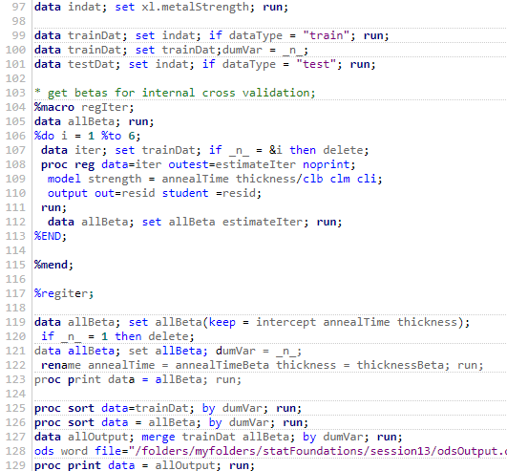

SAS Code for Questions
SAS Macro Programming Here to Run Regression six times

Slide 35
Question 1 Answer

Slide 36
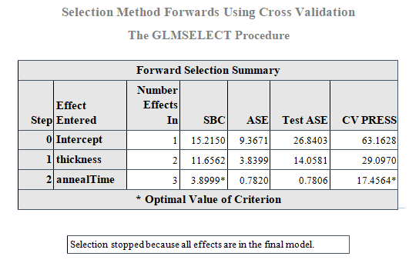
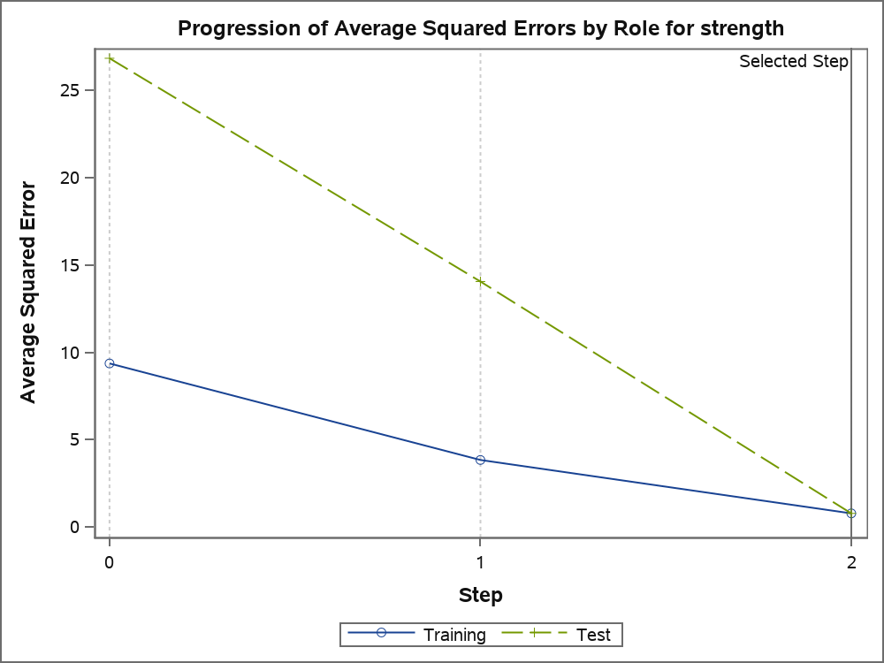
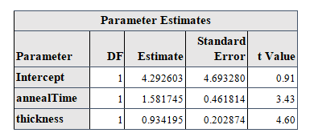
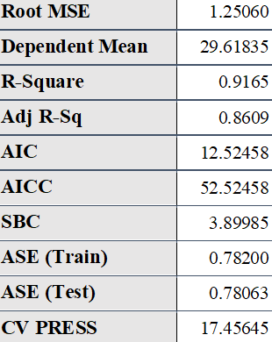
Question 2 Answer

Slide 37
Summary
Analyzing Influential Observations
Studentized residuals
Leverage
Cook's D
Adding Quadratic Terms to the Model
Analysis of Multicollinearity using the variance inflation factor (VIF)
Subset Regression Using F-statistic – compare regression models
Internal Cross Validation Using CVPress
External Cross Validation with test and train datasets
Variable Selection Algorithms
Forward Elimination
Backward Elimination
LASSO

